Slide 1
NODE.JS
(The Backend Of MERN Stack)
Lecture 3

Slide 2
Today’s Agenda
Introduction To Modules
Types Of Node Modules
Using require() Function
Some examples of require()

Slide 3
What is a module ?
In simple terms, a module is a piece of reusable JavaScript code.
It could be a .js file or a directory containing .js files.
We can export the content of these files and use them in other files.

Slide 4
BenefitS of using a module
Modules help developers follow the DRY (Don't Repeat Yourself) principle in programming.
They also help us to break down some complex logic into small, simple, and manageable chunks.

Slide 5
BenefitS of using a module
Specifically in Node.js modules allow us to perform many important tasks like:
read or write from the file system
connect to a database
start up a web server

Slide 6
Types of modules in node.js
There are three main types of Node modules that you will work with as a Node.js developer.
They include the following:
Built-in Modules/ Core Modules
Local Modules
Third-Party Modules

Slide 7
Core modules of node.js
Node.js comes with some modules pre-installed into it and such modules are called as built-in or core modules .
This means that these modules are available for use when we install Node.js.

Slide 8
Core modules of node.js
The following table lists some of the important core modules in Node.js.
Core Module | Description
fs | fs module includes classes, methods, and events to work with file I/O.
querystring | querystring module includes methods to deal with query string.
path | path module includes methods to deal with file paths.
http | http module includes classes, methods and events to create Node.js http server.
util | util module includes utility functions useful for programmers.

Slide 9
Loading core modules
Before we can use any of the previously mentioned core modules we first need to import them or load them in our file.
To do this we call a function called require() which is a predefined function in Node.js , specifically used for importing other modules in our JS file.

Slide 10
Can’t we use import in node.js ?
To understand the answer to this question, we must first understand types of module system in Node.js.
Node.js has mainly two module systems:
CommonJS modules and
ECMAScript modules.
CommonJS is the default module system in Node.js .

Slide 11
Can’t we use import in node.js ?
Now since CommonJS is the default module system in Node.js it always uses require() function for importing modules while import is used for including ES6 modules .
As of now, the Node.js environment doesn’t support ES6 import directly.
So if we try to use the import keyword for importing modules directly in Node js then it will throw error

Slide 12
Can’t we use import in node.js ?
If at all we want to use import for including modules then we can do so in the following ways:
1. Using ".mjs" extension
The first way to use the ES6 import statement in Node.js is to save the JavaScript file with the ".mjs" extension, instead of using the typical ".js" extension.
2. Making changes in package.json file
The second way is to include a package.json file in our project and set {“type”:”module”} in it.

Slide 13
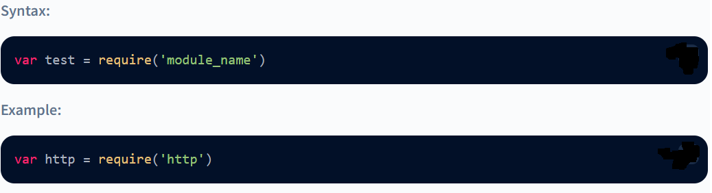
Syntax of require()
Argument: Name of the module.
Return value: The require() function can return an object or a function or a property or any other JavaScript type, depending on what the specified module returns.

Slide 14
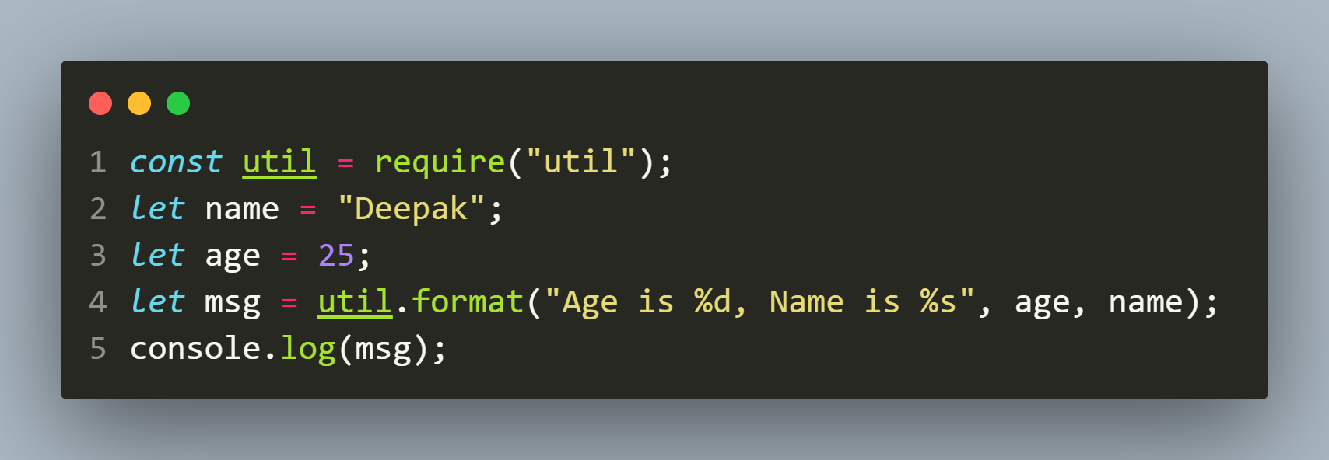
Example of using util module

Slide 15
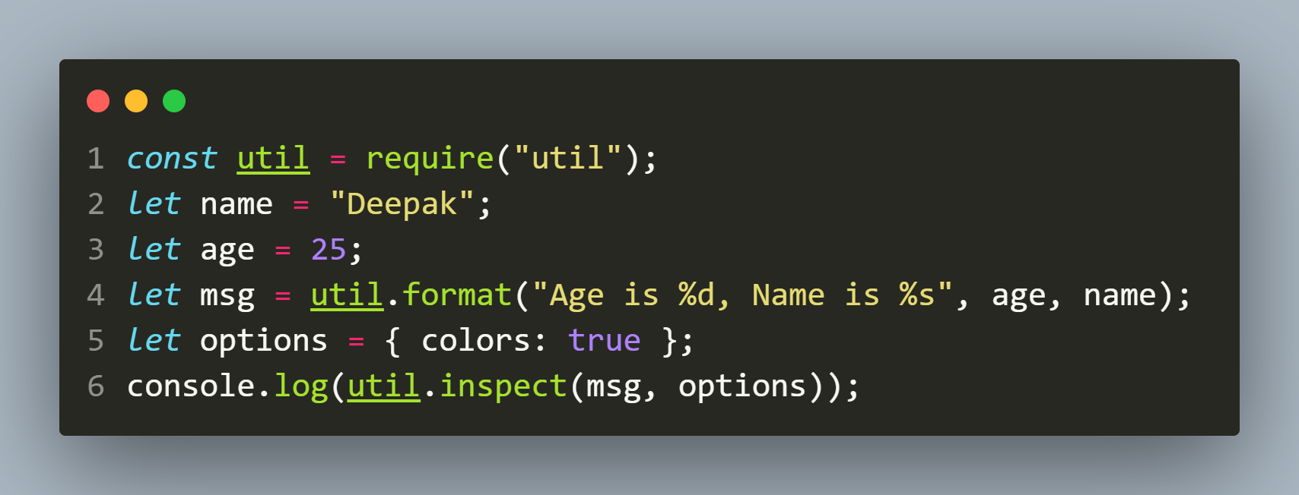
Example of using util module

Slide 16
FORMAT SPECIFIERS WITH util.format()
Format Specifier | Used For
%s | string
%d, %f | number
%o | array,objects
%j | jSON
%s,%d | boolean

Slide 17
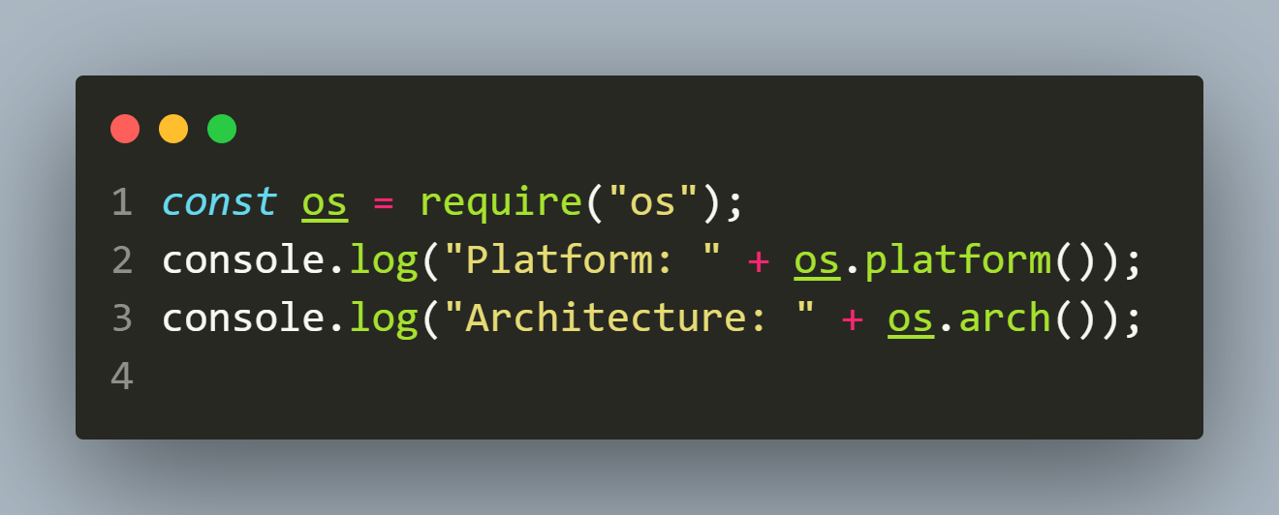
Example of using os module

